Slide 1
Introduction to A*
An algorithm to find a route to the goal according to some optimality criteria
Thanks to http://www.redblobgames.com/pathfinding/a-star/introduction.html

Slide 2
Path planning is a well-known concept in a lot of scenario, expecially in industrial automation, car manufactoring and even in game development.
It’s not difficult to meet a problem in which, the car or maybe the robot, have to go from here to there; often it can not pass through walls.
So there’s the problem to find the path, the «optimal» path.
First of all: Which is the optimal path?
Path planning context

Slide 3
Path planning is a well-known concept in a lot of scenario, expecially in industrial automation, car manufactoring and even in game development.
It’s not difficult to meet a problem in which, the car or maybe the robot, have to go from here to there; often it can not pass through walls.
So there’s the problem to find the path, the «optimal» path.
First of all: Which is the optimal path?
Shortest path
Minimum number of turns
Feasible path
Path with the highest speed
Path with minimum time
Path planning rules

Slide 4
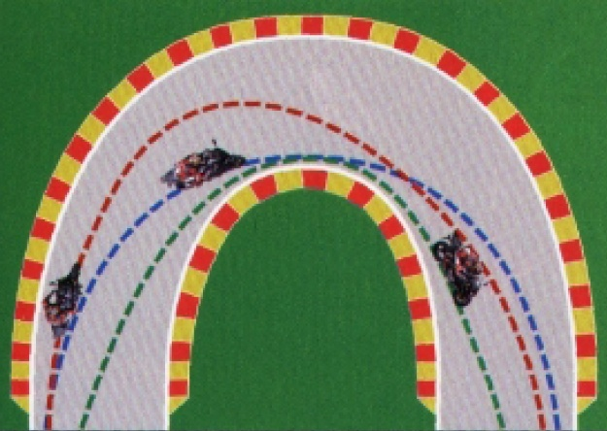
Google maps:
the optimal is minimum time, even consider traffic jam.
MotoGP:
the optimal is minimum time. But if you are overlapping someone?
Path planning example

Slide 5
Generating a path planner is not so easy; And the context is very important.
There are a lot of studies about that, a lot of algorithm were proposed and, in general, maybe the algorithm is the best for a task but, for your task, it may be not.
In our context we want to find a path which is:
Short, in the sense «do not waste time»
Feasible
To do that, it’s necessary to know all the area «the map» between the start and the end point.
Path planning in our context

Slide 6
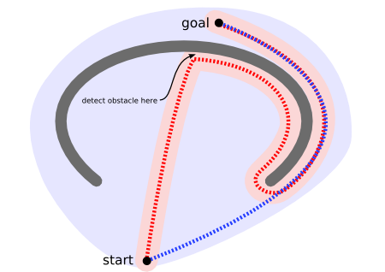
Consider the following situation: a vehicle that is only able to sense in a close range is initially at the bottom of the map and wants to get to the top. There is nothing in the area it scans (shown in pink) to indicate that the unit should not move up, so it continues on its way. Near the top, it detects an obstacle and changes direction.
It then finds its way around the “U”-shaped obstacle, following the red path.
In contrast, a vehicle with the knowledge of the map and a “pathfinder” would have scanned a larger area (shown in light blue), but found a shorter path (blue), never sending the unit into the concave shaped obstacle.
Pathfinder

Slide 7
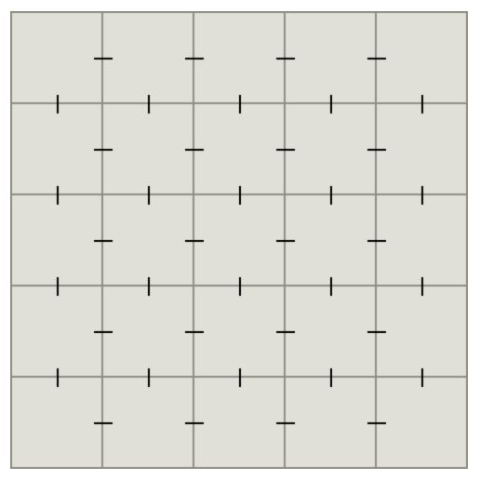
The pathfinding algorithms from computer science textbooks work on graphs in the mathematical sense: a set of vertices with edges connecting them. A tiled game map can be considered a graph with each tile being a vertex and edges drawn between tiles that are adjacent to each other:
From the graphs represented in this way we can construct
two-dimensional grids (maps represented as images!)
Pixel 1,1
Pixel 1,2
Pixel 1,3
Pixel 2,1
Pixel 2,2
Pixel 2,3
Grid

Slide 8
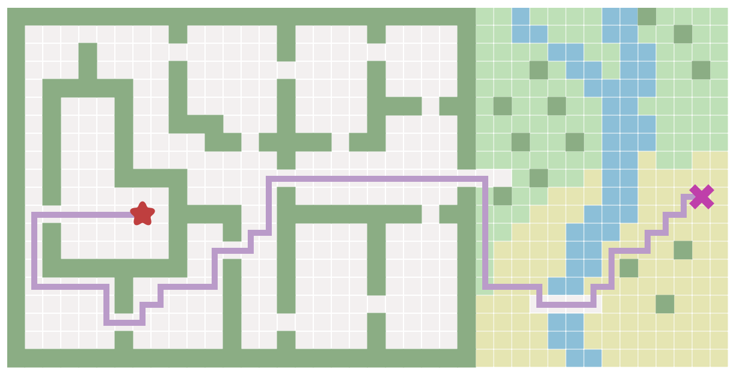
In games we often want to find paths from one location to another. We’re not just trying to find the shortest distance; we also want to take into account travel time. In this map, walking through water is significantly slower, so we want to find a path that avoids water when possible.
Game map example

Slide 9
How would we calculate this path? A* is the most commonly used algorithm in games.
It is one of a family of graph search algorithms that follow the same structure. These algorithms represent the map as a graph and then find a path in that graph. For image based maps, graph nodes will be locations on the map. Breadth First Search is the simplest of the graph search algorithms, so let’s start there, then up to A*.
The key idea for all of these algorithms is that we keep track of an expanding ring called the Frontier. Let’s see an animation to see how the frontier expands!

Slide 10
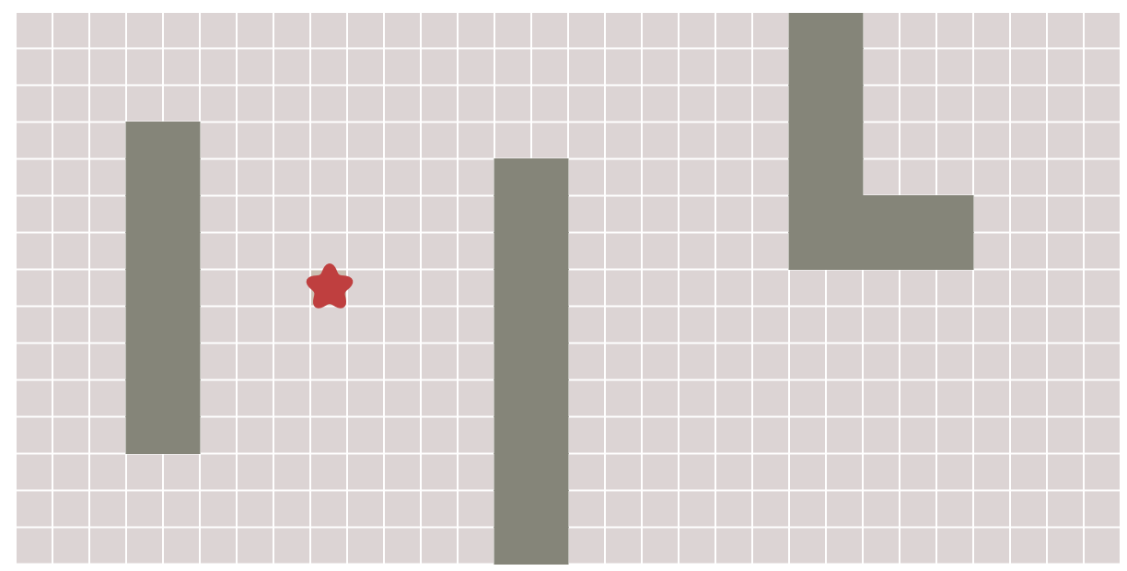
The frontier

Slide 11
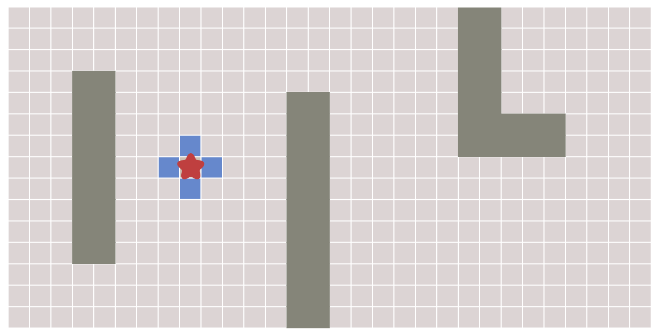
1
1
1
1
The frontier

Slide 12
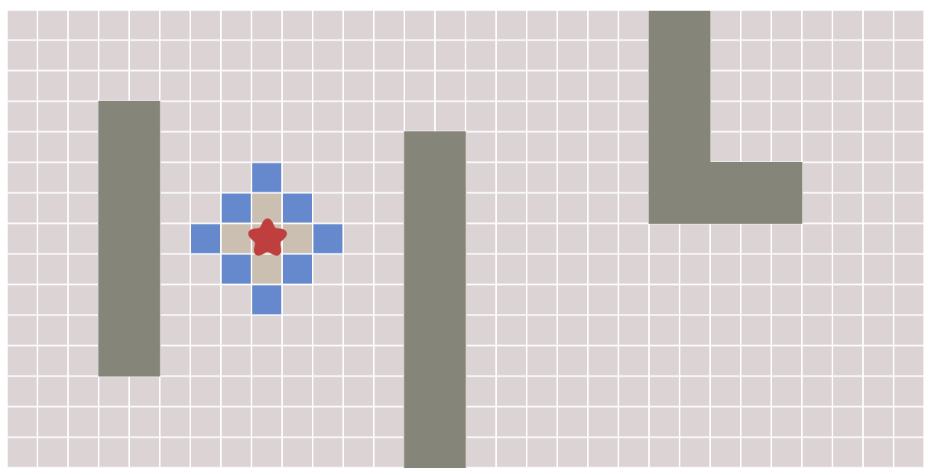
2
2
1
2
2
1
1
2
2
1
2
2
The frontier

Slide 13
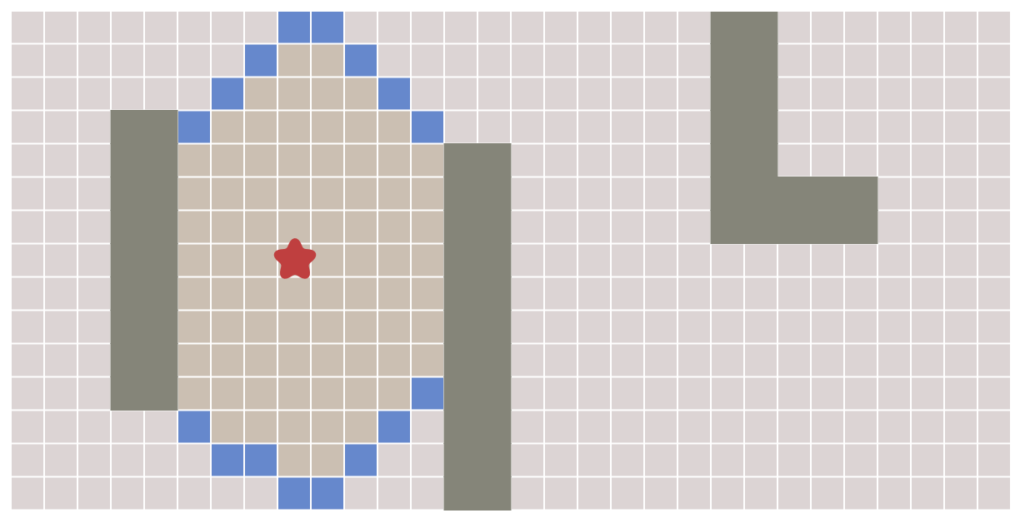
8
8
8
2
2
1
2
2
1
1
2
2
1
2
2
8
8
8
8
8
The frontier

Slide 14
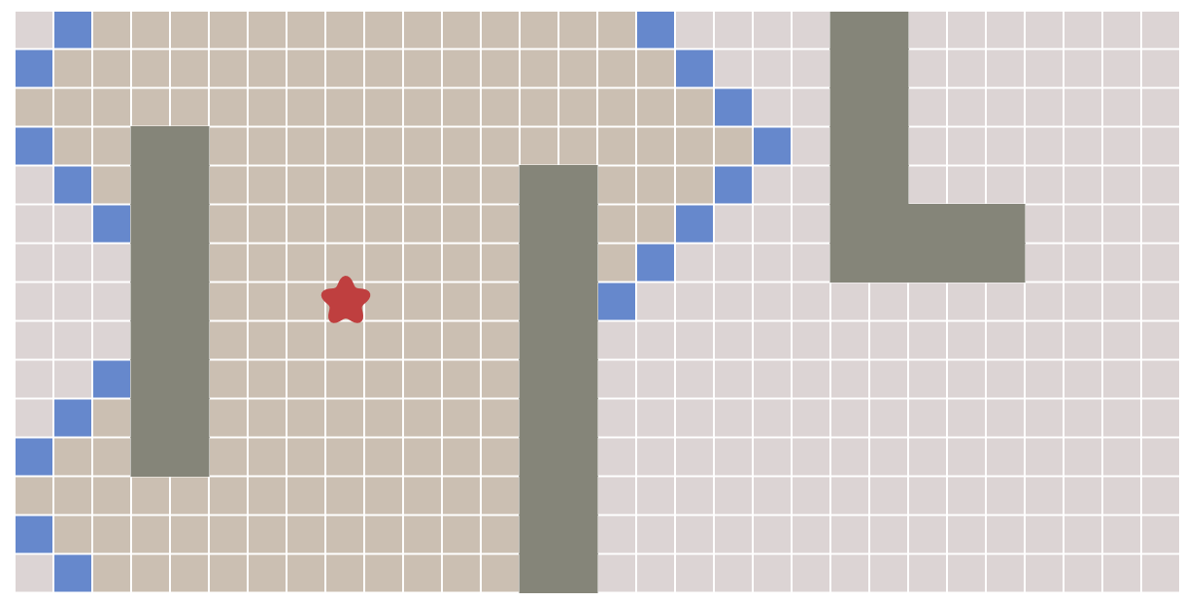
15
15
15
15
The frontier

Slide 15
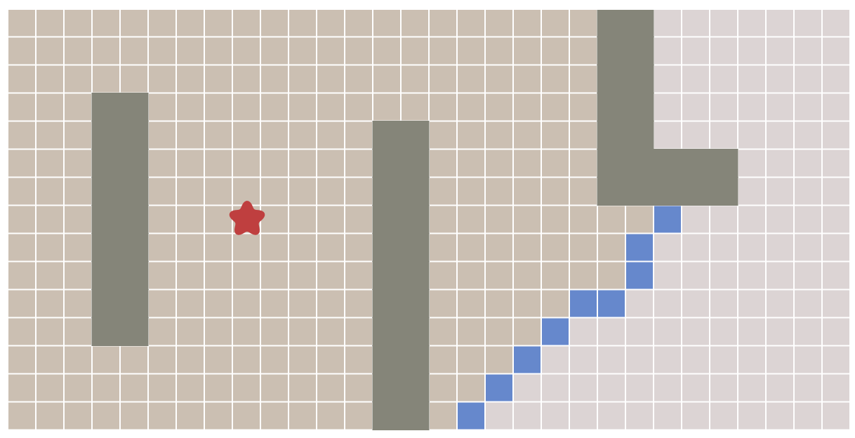
The frontier

Slide 16
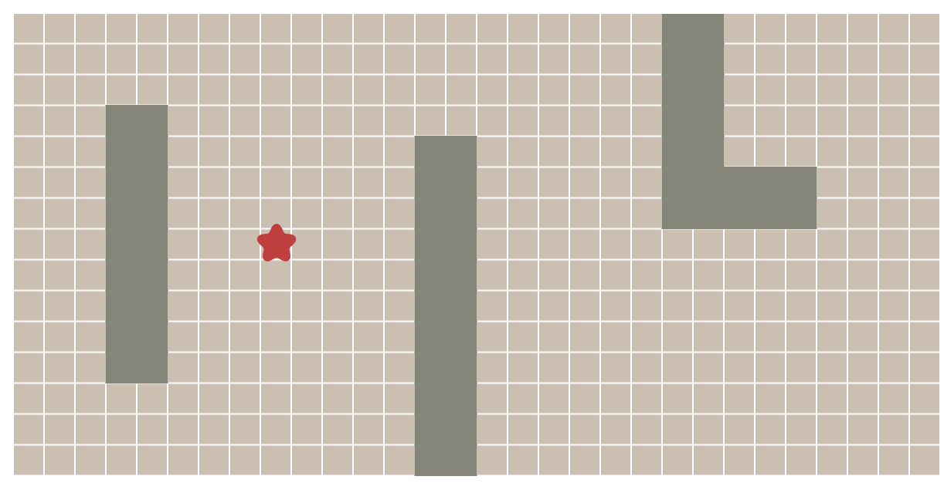
The frontier

Slide 17
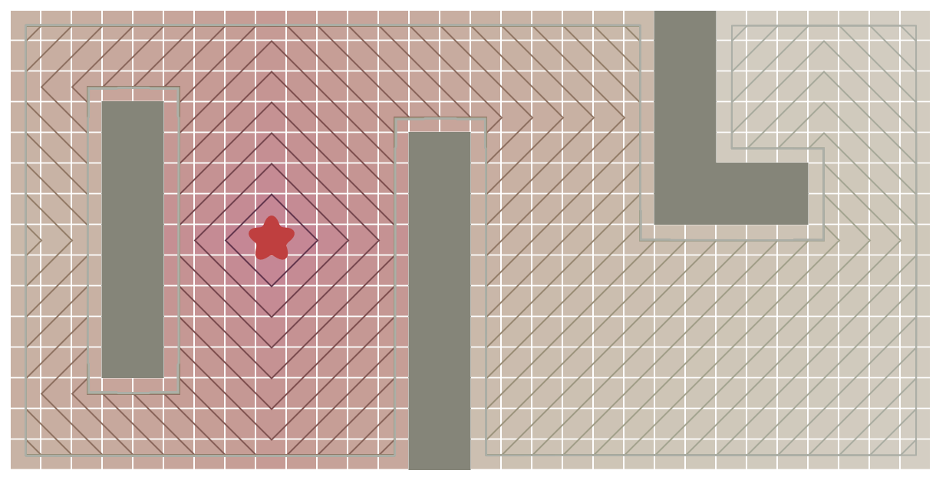
The expanding frontier can be viewed as contour lines that stop at walls; this process is sometimes called “flood fill”:
The expansion process

Slide 18
How do we implement this?
Repeat these steps until the frontier is empty:
Pick and remove a location from the frontier.
Mark the location as visited so that we know not to process it again.
Expand it by looking at its neighbors. Any neighbors we haven’t seen yet we add to the frontier.
Let’s see this up close. The tile are numbered in the order we visit them. Let’s step through to see the expansion process:
The expansion process

Slide 19
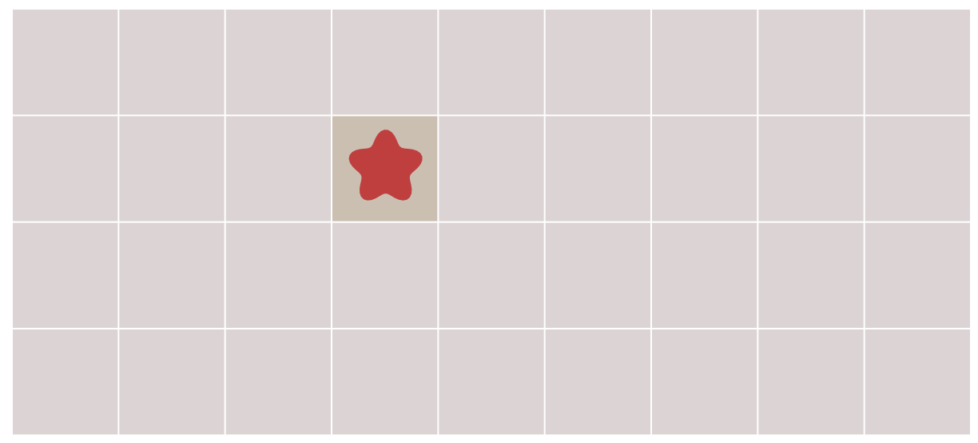
Let’s see this up close. The tile are numbered in the order we visit them. Let’s step through to see the expansion process:
The expansion process

Slide 20
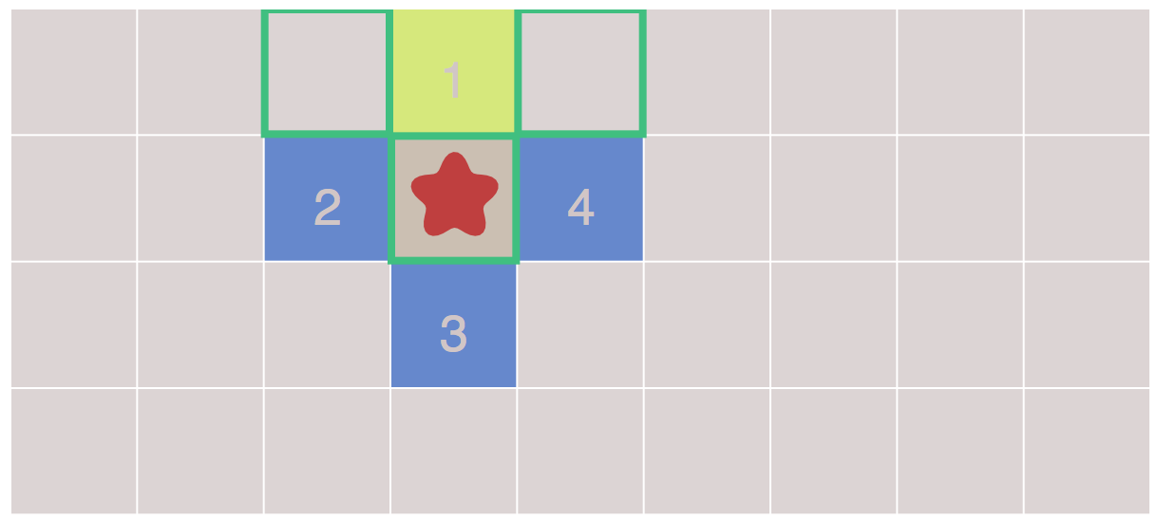
6
5
The expansion process

Slide 21
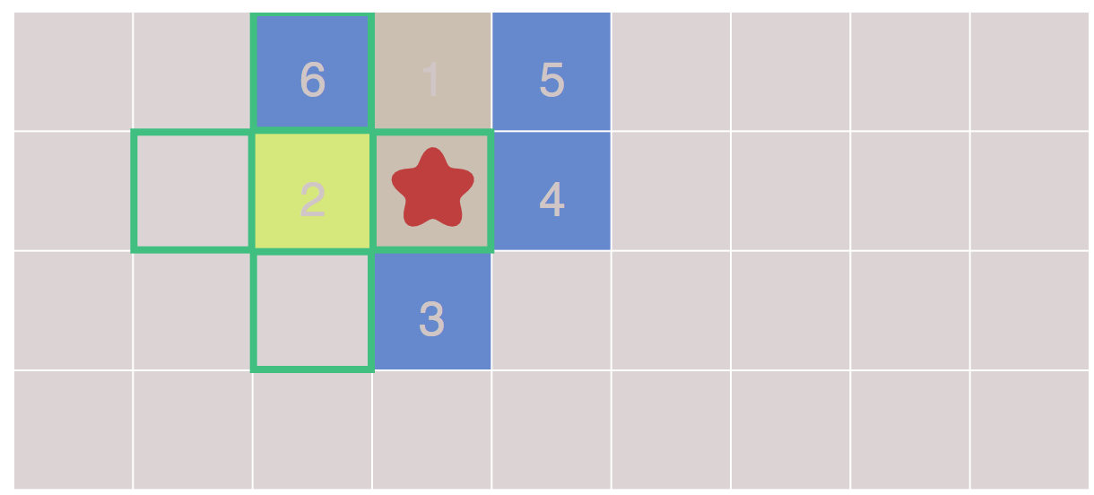
7
8
The expansion process

Slide 22
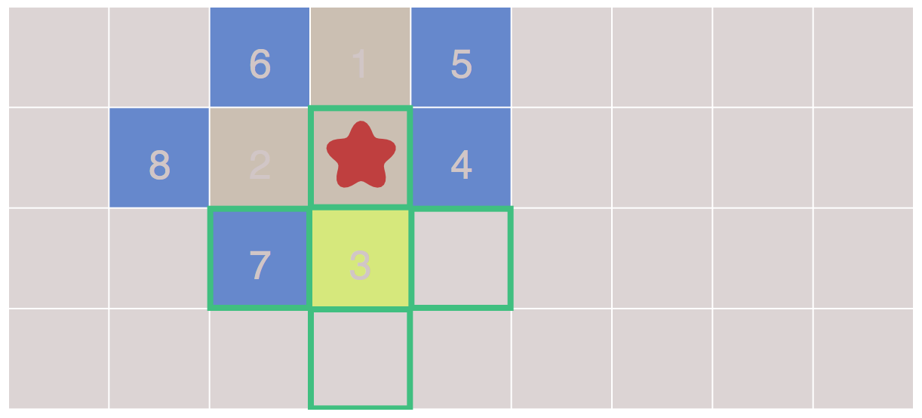
10
9
The expansion process

Slide 23
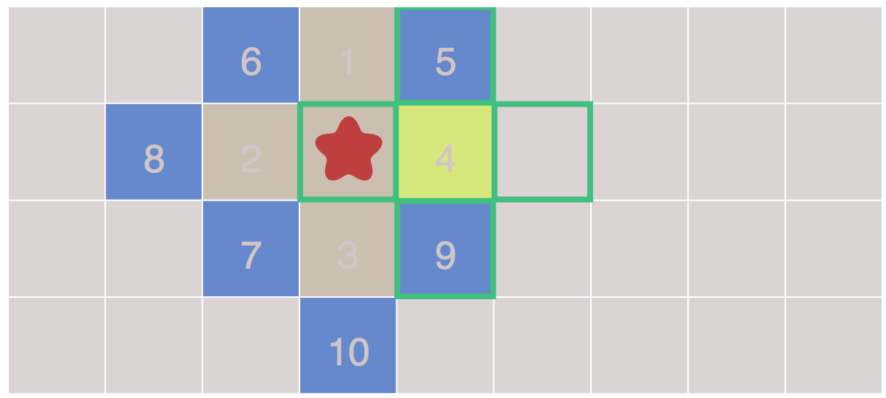
11
The expansion process

Slide 24
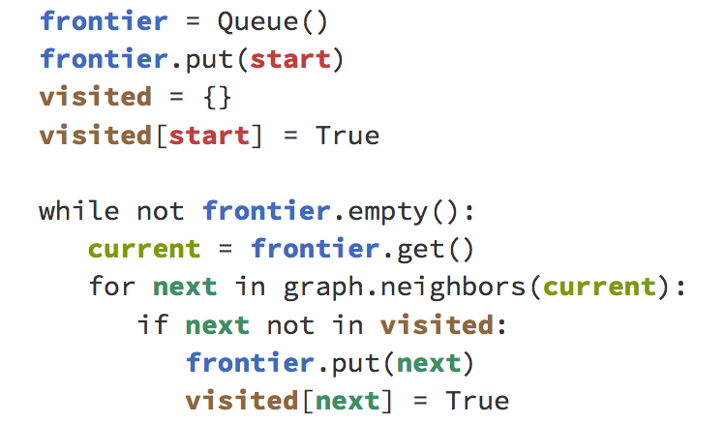
The expansion process

Slide 25
This loop is the essence of the graph search algorithms on this page, including A*. But how do we find the shortest path? The loop doesn’t actually construct the paths; it only tells us how to visit everything on the map.
That’s because Breadth First Search can be used for a lot more than just finding paths:
tower defence,
distance maps,
procedural map generation,
…and lots of other things.
The expansion process

Slide 26
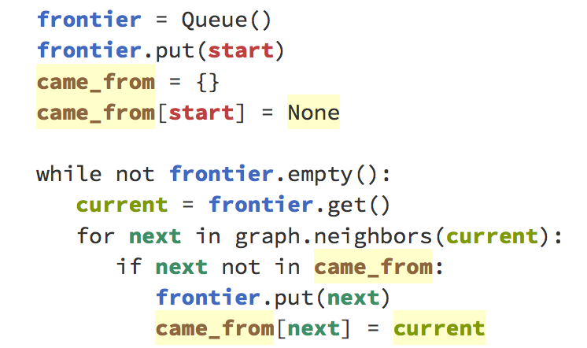
Here though we want to use it for finding paths, so let’s modify the loop to keep track of where we came from for every location that’s visited, and rename visited with came_from:
The expansion process

Slide 27
In the graphs represented in
two-dimensional grids (maps represented as images!), for each cell we have four pointers that now we can use to store the coming location.
Grid

Slide 28
Now came_from for each location points to the place where we came from. Let’s copy each pointing reference with an arrow:
The expansion process

Slide 29
6
5
The expansion process

Slide 30
7
8
The expansion process

Slide 31
10
9
The expansion process

Slide 32
11
The expansion process

Slide 33
Let’s copy each arrow below:
6
5
7
8
10
9
The expansion process

Slide 34
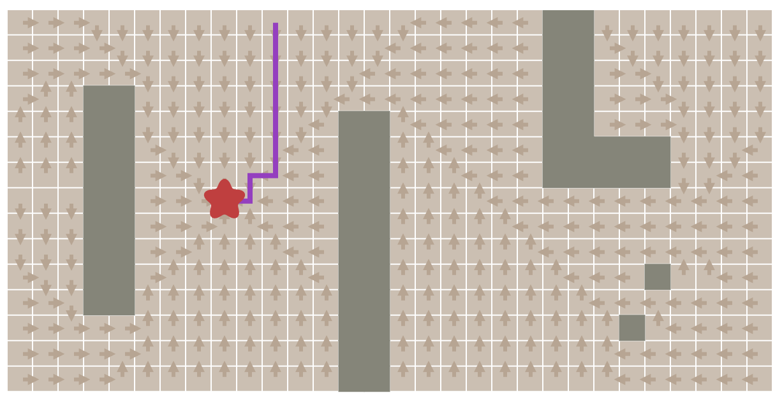
Now let’s take a look at the entire picture.
See how the arrows providers a reverse path back to the start position!!!
Start
Goal
Reconstruction of the path

Slide 35
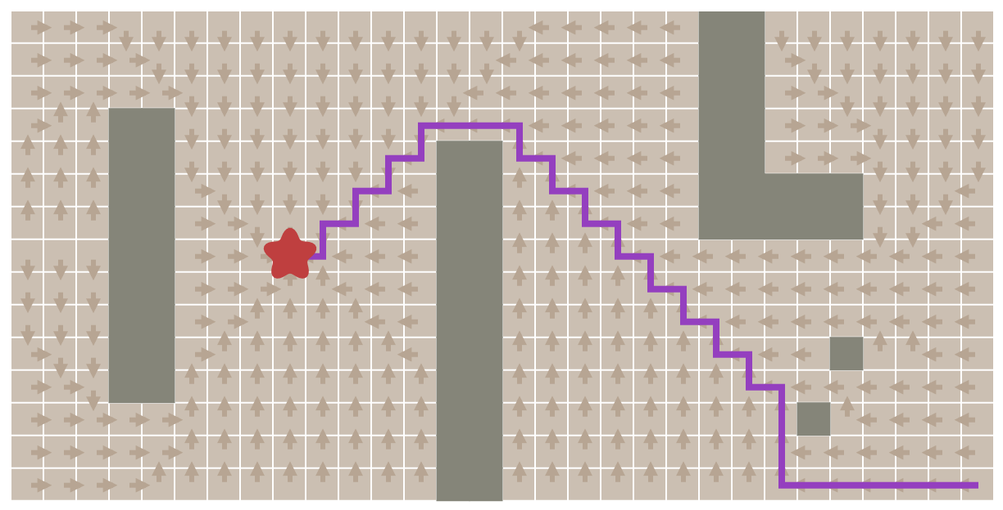
Goal
Start
Reconstruction of the path

Slide 36
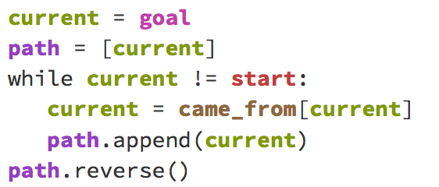
The code to reconstruct paths is simple: just follow the arrows
Reconstruction of the path

Slide 37
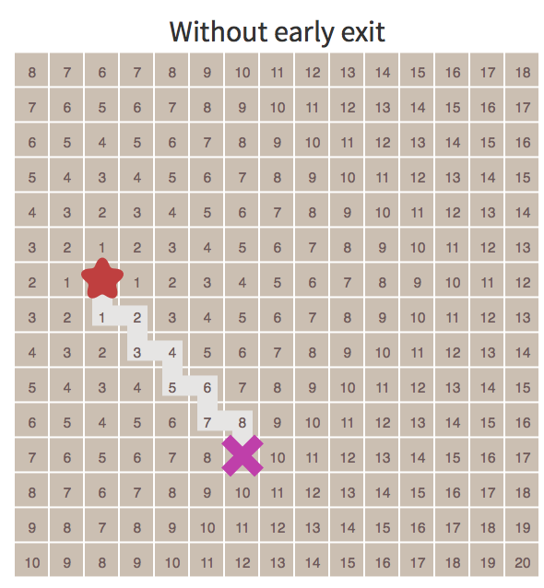
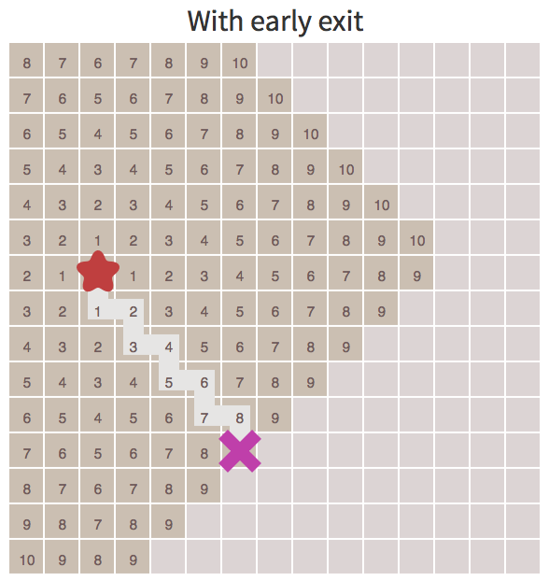
We’ve found paths from one location to all other locations. Often we don’t need all the paths; we only need a path from one location to one other location. We can stop expanding the frontier as soon as we’ve found our goal. See how the frontier stops expanding as soon as it reaches the X.
Early EXIT

Slide 38
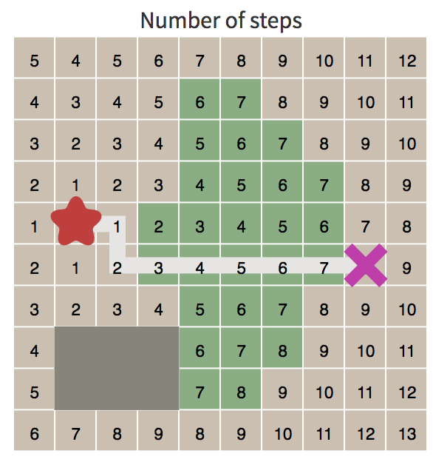
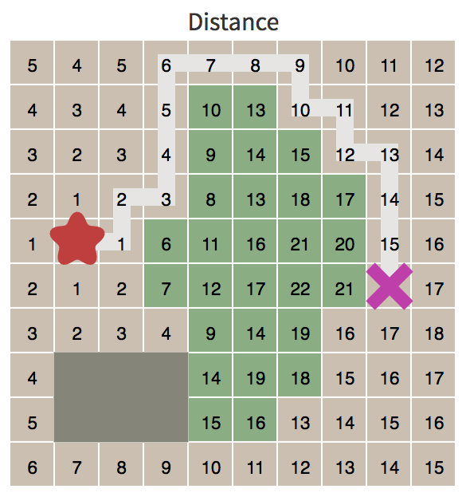
So far we’ve made step have the same “cost”.
In some pathfinding scenarios there are different costs for different types of movement. For example in the initial map, walking through water cost 10 times as much as walking through grass.
Another example is diagonal movement on a grid that costs more than axial movement.
We’d like the pathfinder to take these costs into account.
?
Movement costs

Slide 39
We want to use Dijkstra’s Algorithm for this!
How does it differ from Breadth First Search?
We need to track movement costs, so let’s add a new variable, cost_so_far, to keep track of the total movement cost from the start location.
We want to take the movement costs into account when deciding how to evaluate locations; let’s turn our queue into a priority queue.
IF we end up visiting a location multiple times, so, instead of adding a location to the frontier if the location has never been visited, we’ll add it if the new path to the location is better than the best previous path.
Altering a little the logic

Slide 40
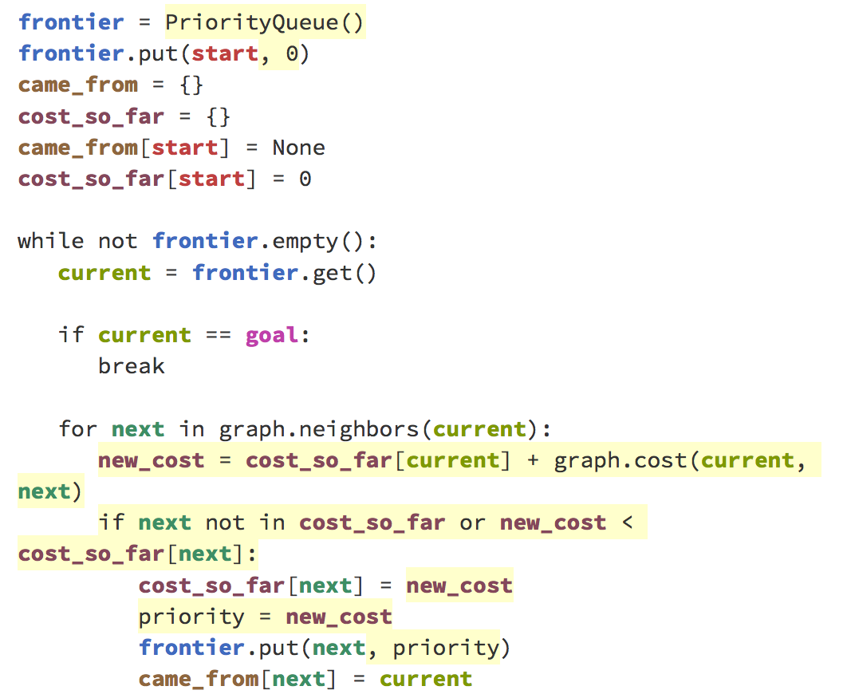

Slide 41
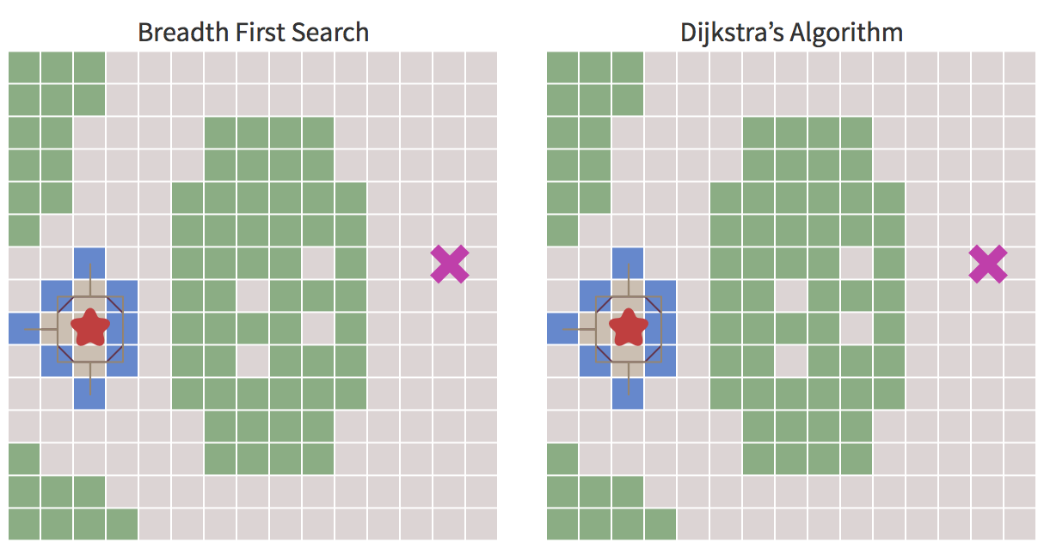
Using a priority queue instead of a regular queue changes the way the frontier expands. Contour lines are one way to see this. Start the animation to see how the frontier expands more slowly through the forests, finding the shortest path around the central forest instead of through it:
Dijkstra’s Algorithm vs Breadth First Search

Slide 42
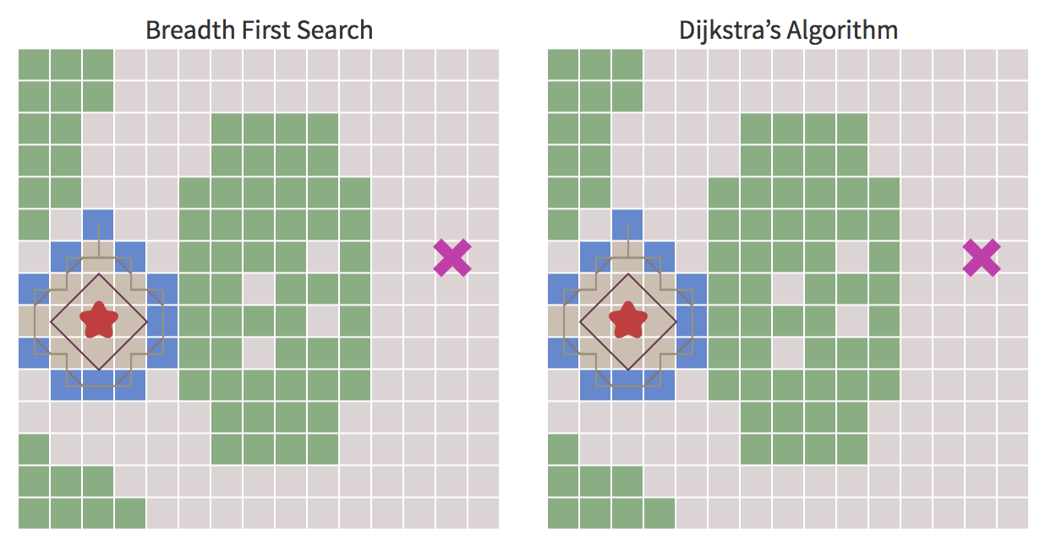
Dijkstra’s Algorithm vs Breadth First Search

Slide 43
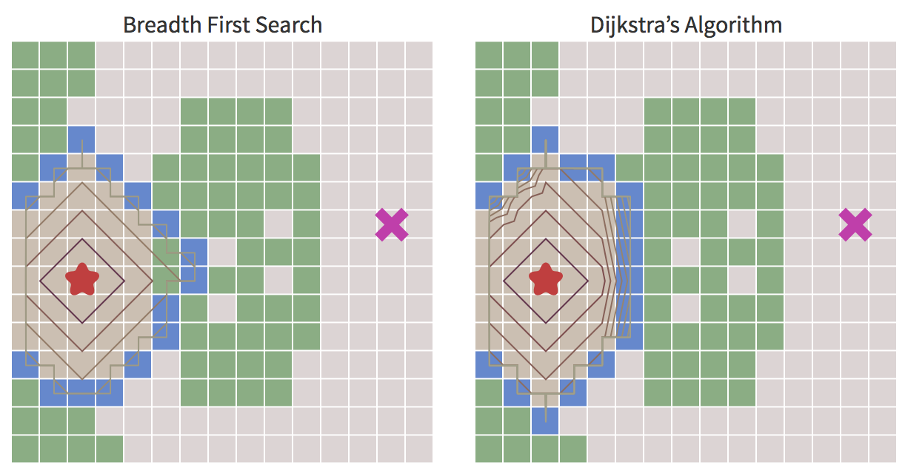
Dijkstra’s Algorithm vs Breadth First Search

Slide 44
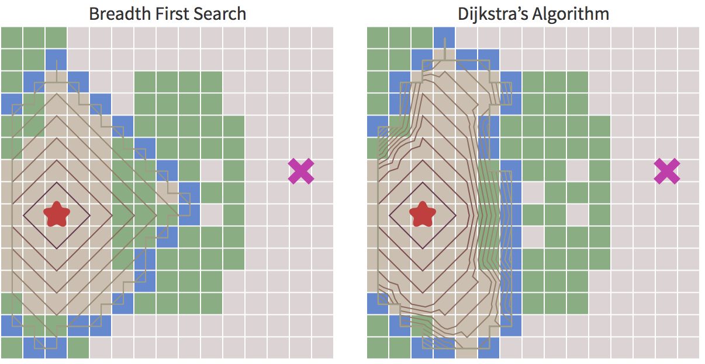
Dijkstra’s Algorithm vs Breadth First Search

Slide 45
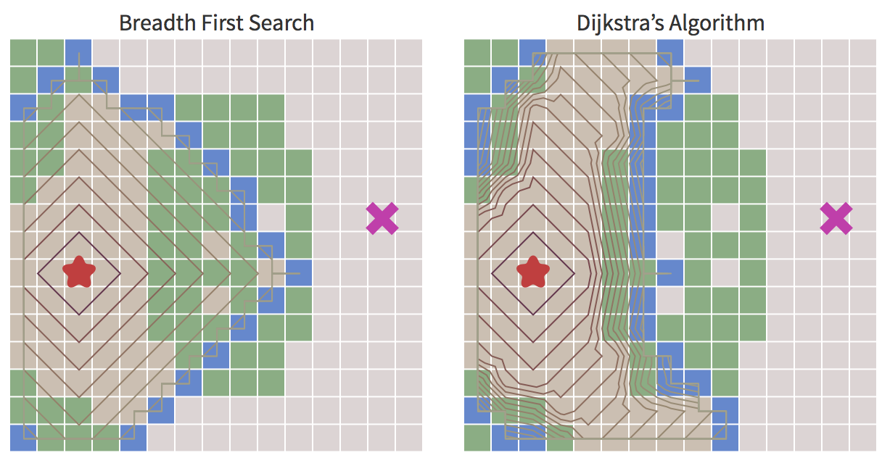
Dijkstra’s Algorithm vs Breadth First Search

Slide 46
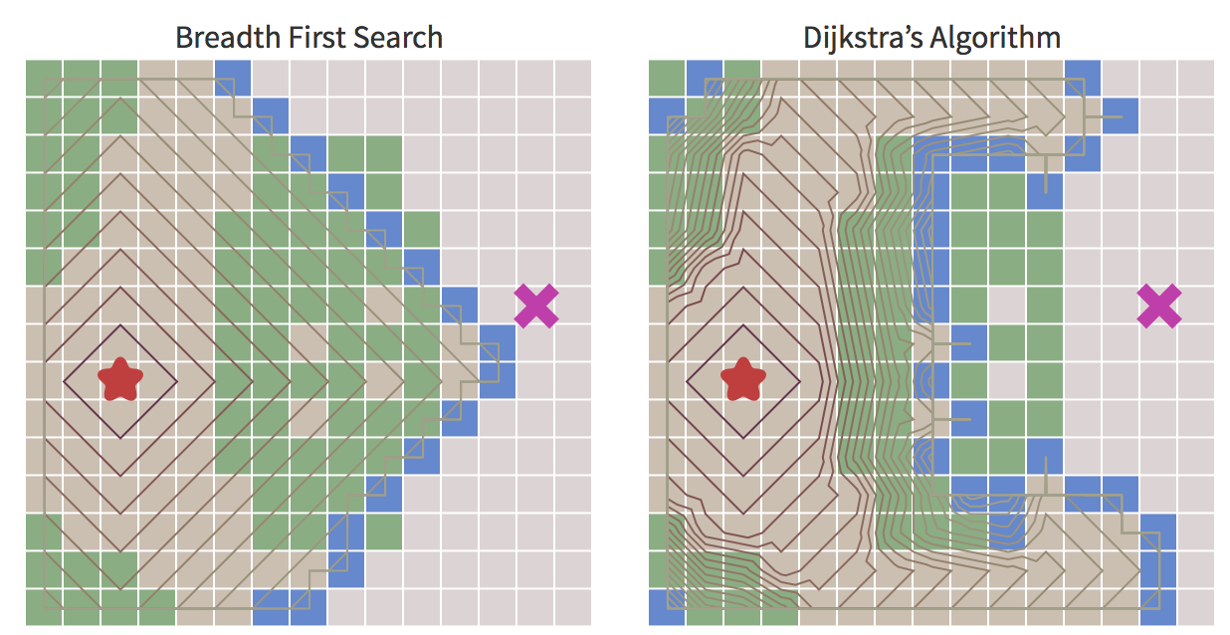
Dijkstra’s Algorithm vs Breadth First Search

Slide 47
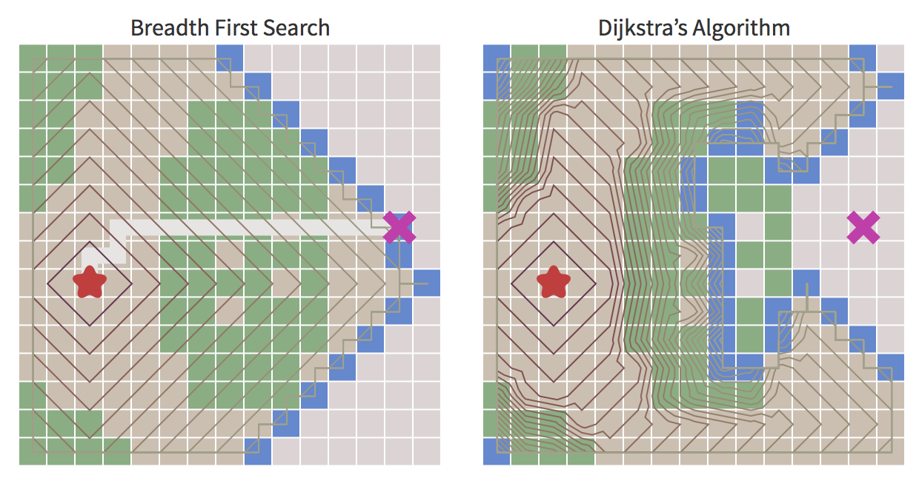
Dijkstra’s Algorithm vs Breadth First Search

Slide 48
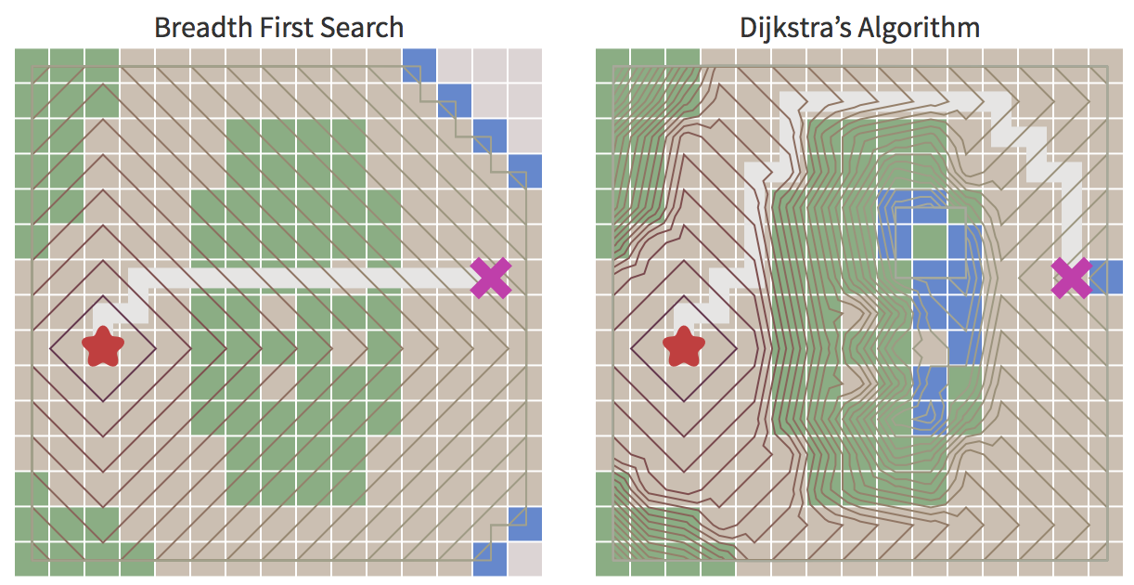
Dijkstra’s Algorithm vs Breadth First Search

Slide 49
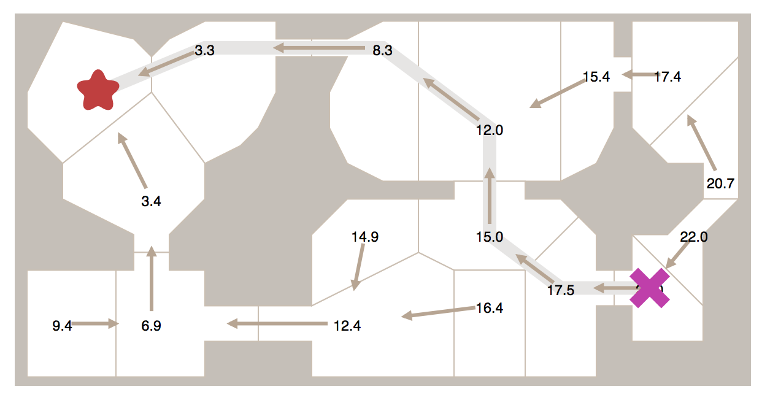
Movement costs other than 1 allow us to explore more interesting graphs, not only grids. Here’s an example where the movement costs are based on distance from room to room:

Slide 50
With Breadth First Search and Dijkstra’s Algorithm, the frontier expands in all directions. This is a reasonable choice if you’re trying to find a path to all locations or to many locations.
However, a common case is to find a path to only one location. Let’s make the frontier expand towards the goal more than it expands in other directions.
In Dijkstra’s Algorithm we used the actual distance from the start for the priority queue ordering.
Now, we’ll define a heuristic function that tells us how close we are to the goal. In Greedy Best First Search, we’ll use the estimated (not real, so in this sense heuristic) distance to the goal for the priority queue ordering: the location closest to the goal will be explored first.
Heuristic search: Greedy Best First Search

Slide 51
One possible heuristic is the sum of the row distance + the column distance (defined Manhattan distance, corresponds to defining close pixel only the 4 adjacent)
The heuristic distance

Slide 52
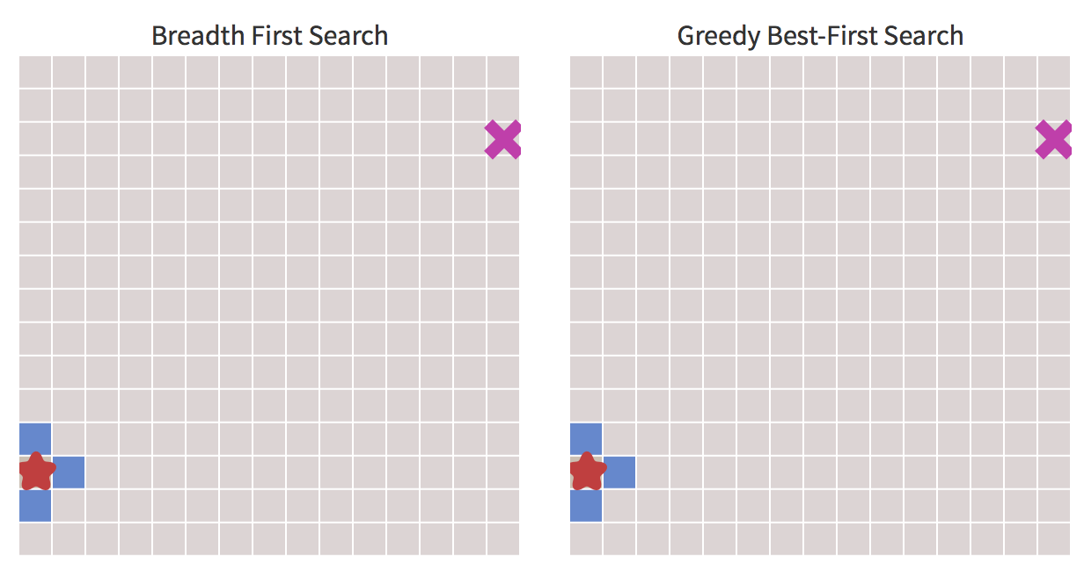
Breadth First Search vs Greedy Best-First Search

Slide 53
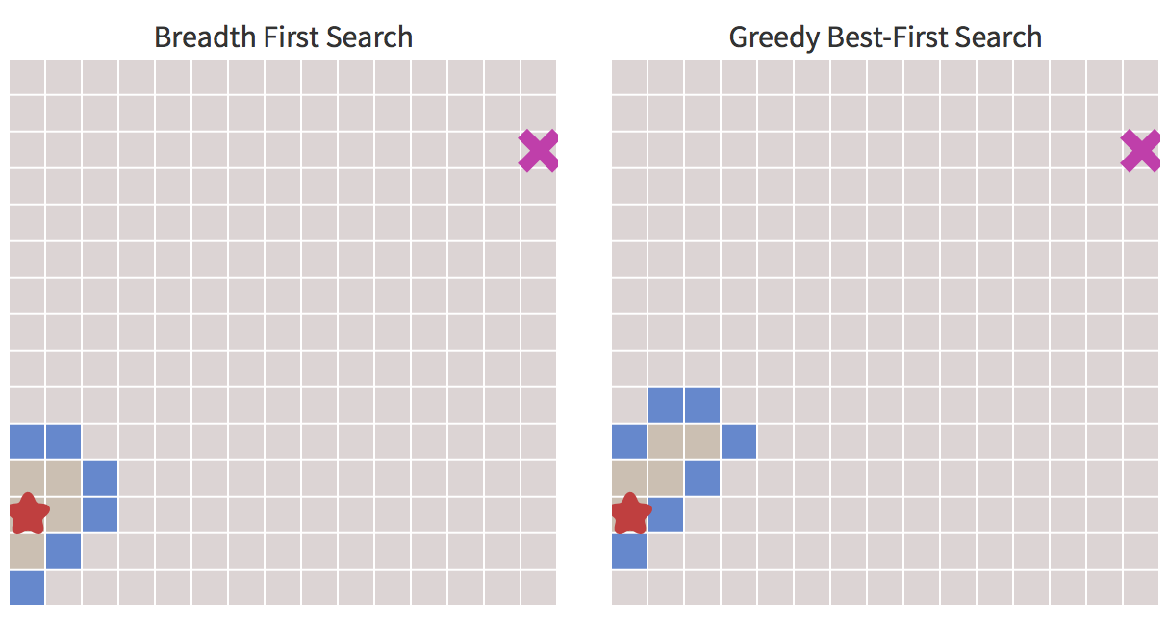
Breadth First Search vs Greedy Best-First Search

Slide 54
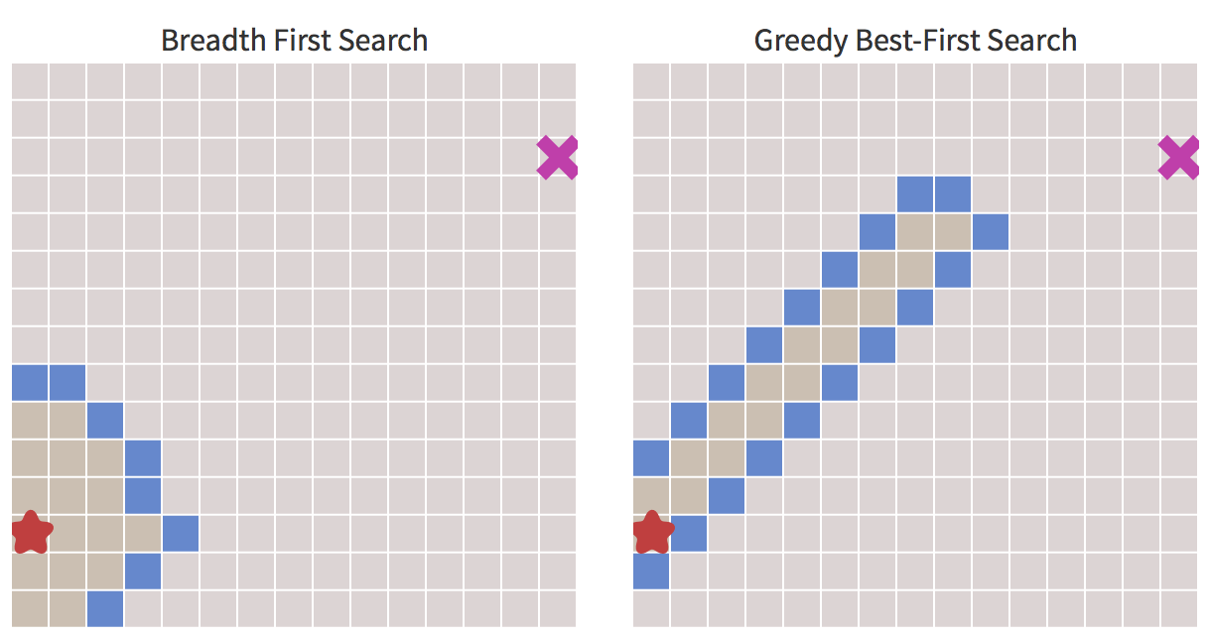
Breadth First Search vs Greedy Best-First Search

Slide 55
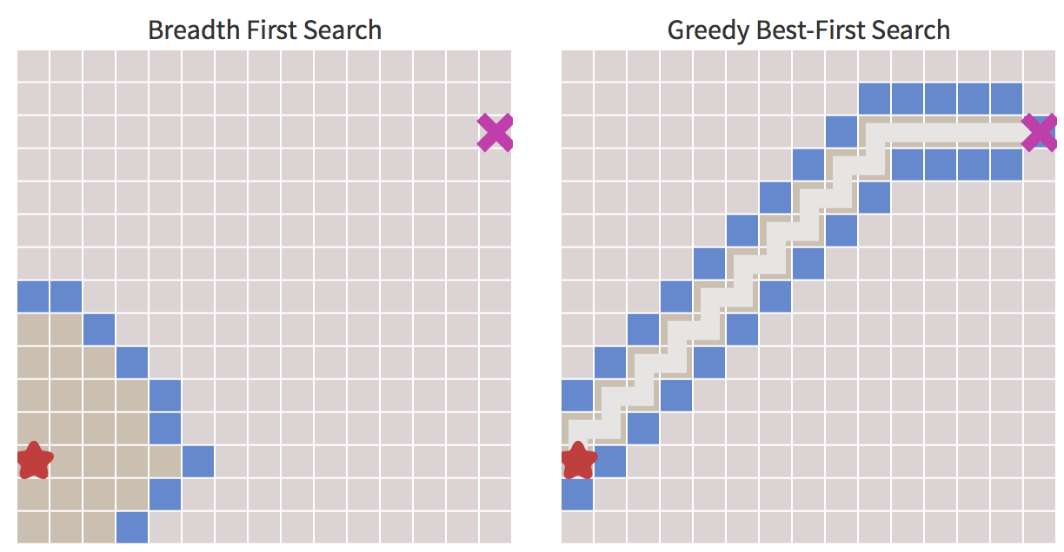
Breadth First Search vs Greedy Best-First Search

Slide 56
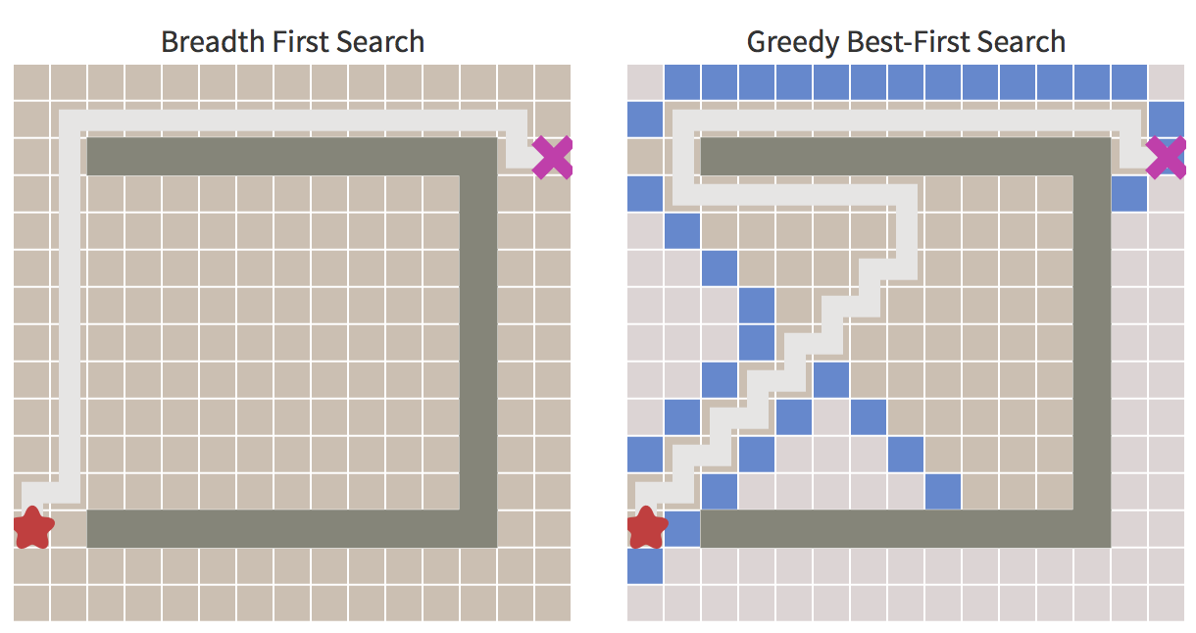
Amazing! But what happens in a more complex map?
The path isn’t the shortest. So this algorithm runs faster but the paths aren’t as good. Can we fix this?
Breadth First Search vs Greedy Best-First Search

Slide 57
The A* algorithm
Can we fix this? Yes!

Slide 58
Dijkstra’s Algorithm works well to find the shortest path, but it wastes time exploring in directions that aren’t promising.
Greedy Best First Search explores in promising directions but it may not find the shortest path.
The A* algorithm uses both the actual distance from the start and the estimated distance to the goal
The A* algorithm

Slide 59
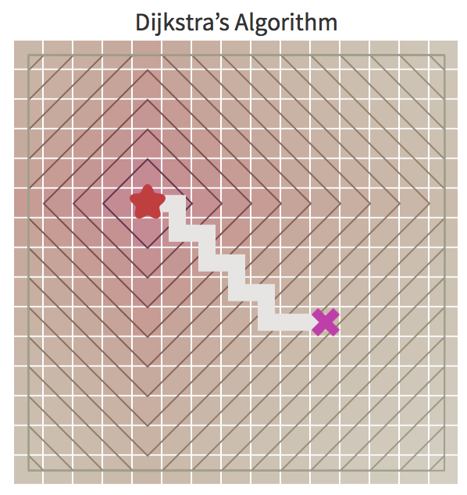
Let’s look at the contour lines for Dijkstra’s Algorithm and Greedy Best First Search. In Dijsktra’s Algorithm, we start at the bottom of a hole centered at the start and climb upwards to find the goal. We’re not sure where the goal is, so we have to check all directions out of the hole.
The A* algorithm

Slide 60
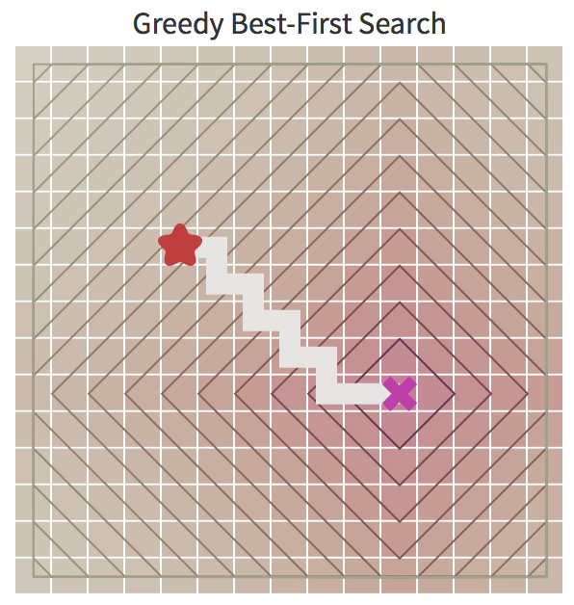
In Greedy Best First Search, we start at the bottom of a hill centred at the goal and climb up a hill to find the goal. We know where the goal is, so as long as we can move in that direction, we’re good.
The A* algorithm

Slide 61
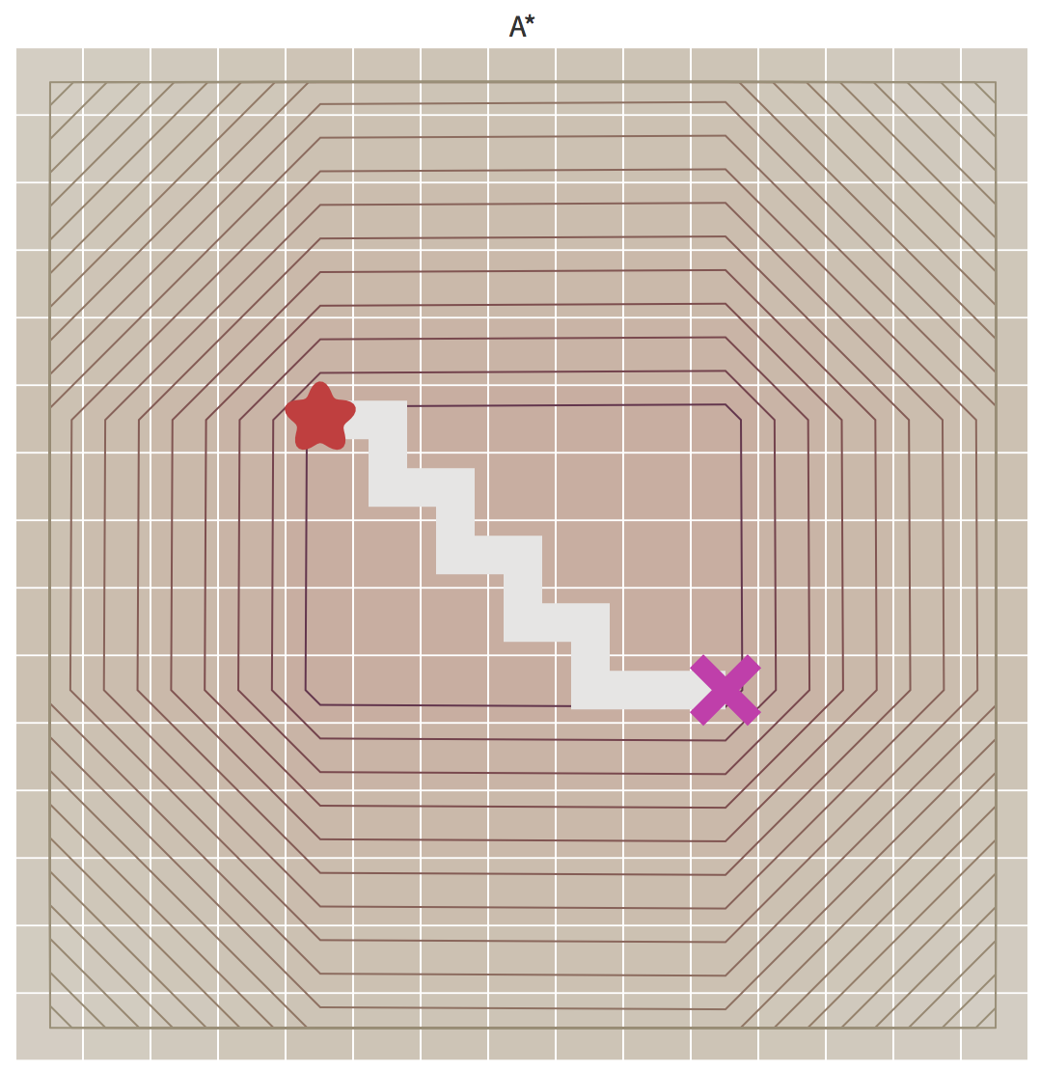
A* combines the two: Instead of contour lines showing distances from start or goal, in A* the contour lines show the length of the paths.
The inner region has the shortest paths. A* starts by exploring that inner region, and moves outwards only if it can’t find a path in there!
The A* algorithm

Slide 62
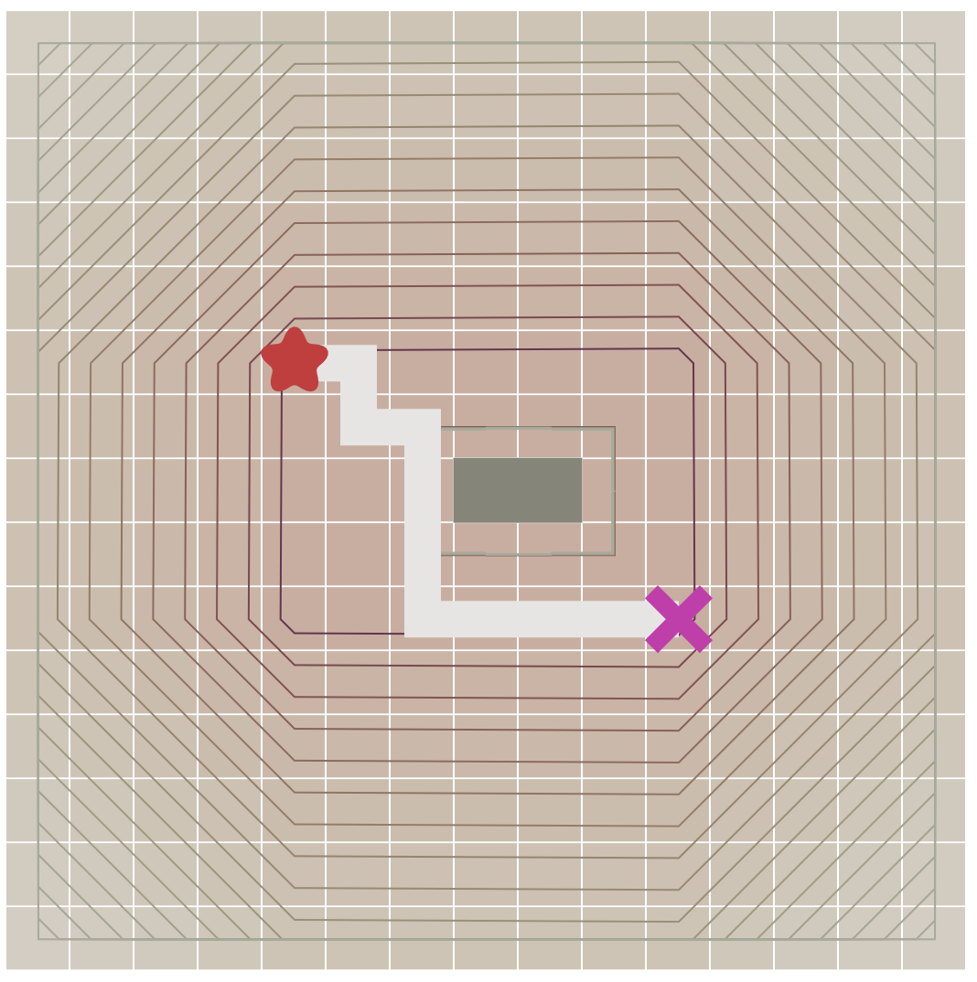
If we add some walls:
The A* algorithm

Slide 63
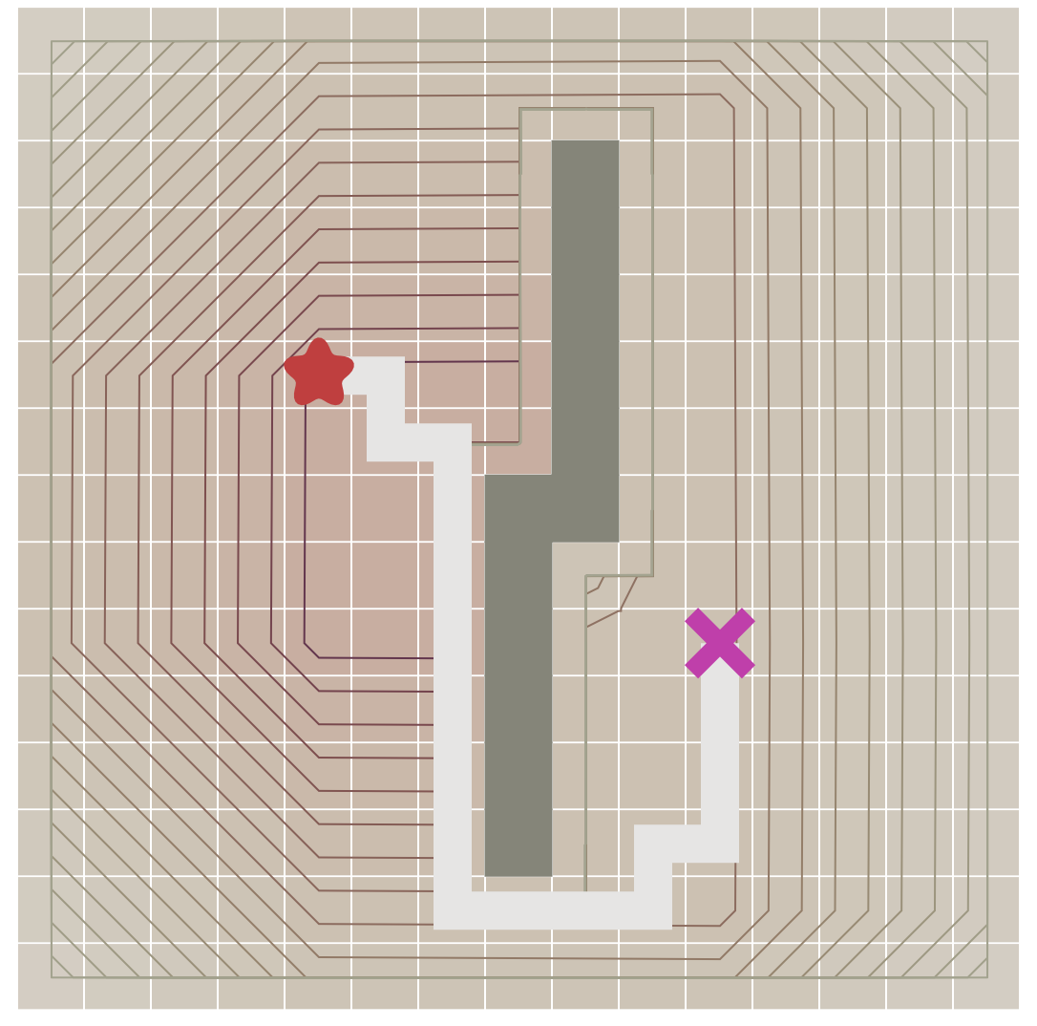
If we add some walls:
The A* algorithm

Slide 64
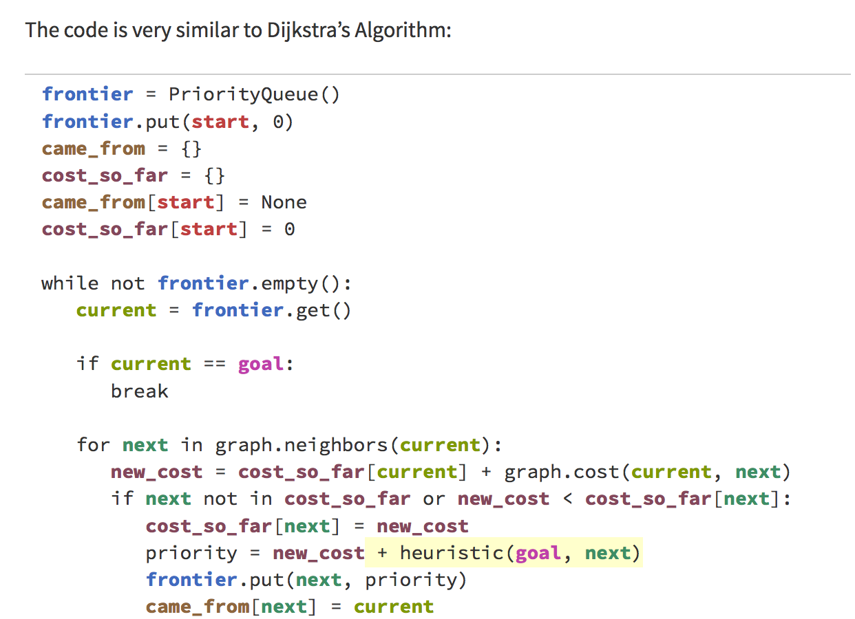
The A* algorithm

Slide 65
The secret to its success is that it combines the pieces of information that Dijkstra’s algorithm uses (favoring vertices that are close to the starting point) and information that Greedy Best-First-Search uses (favouring vertices that are close to the goal).
In the standard terminology used when talking about A*:
g(n) represents the exact cost of the path from the starting point to any vertex n,
h(n) represents the heuristic (for example with Manhattan or Euclidean distance without considering obstacles) estimated cost from vertex n to the goal.
A* balances the two as it moves from the starting point to the goal. Each time through the main loop, it examines the vertex n that has the lowest f(n) = g(n) + h(n).
The A* algorithm

Slide 66
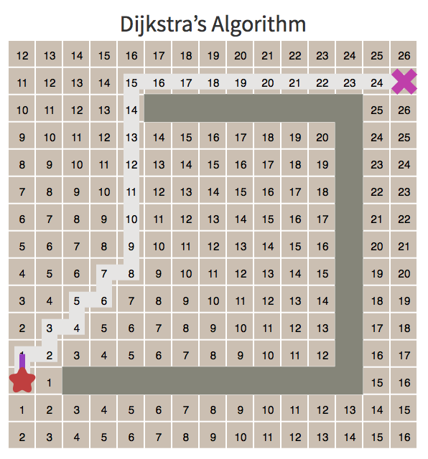
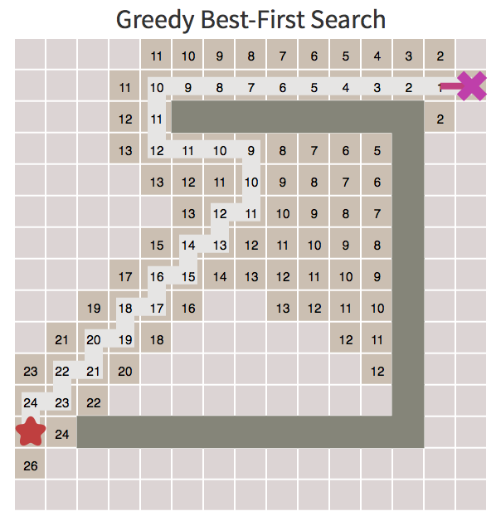
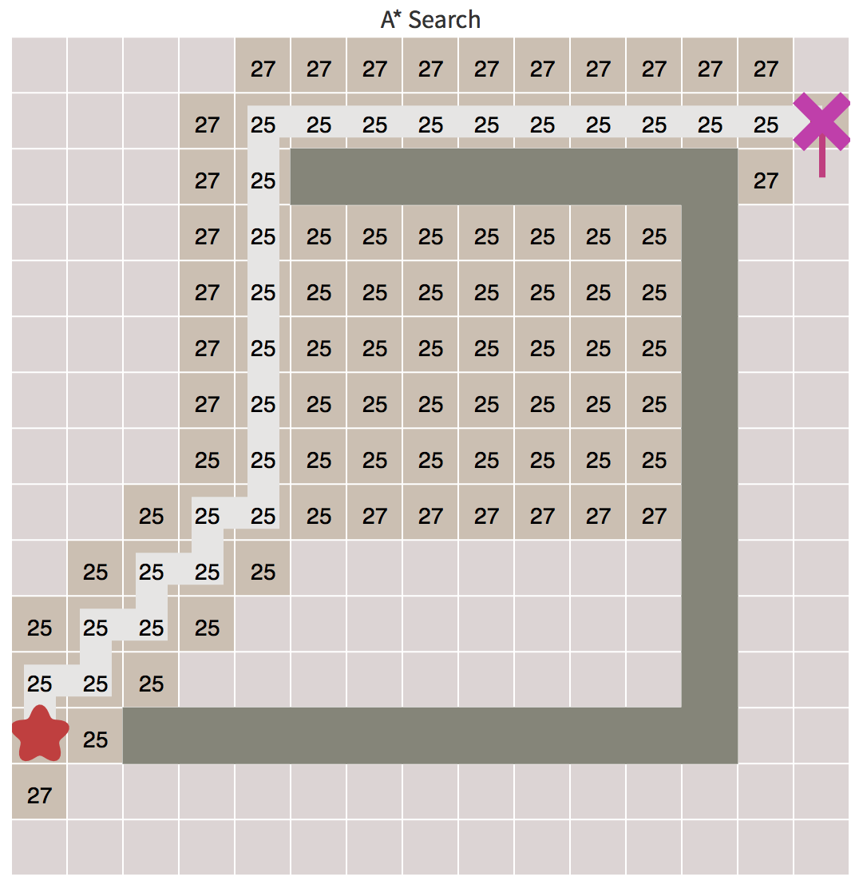
Dijkstra’s Algorithm
+
Greedy Best First
=
A*
+
=
And the path is 25 steps long!
Note that the sum of the costs exactly equal the A* indicator (of length of the path)
Comparison between the different algorithms

Slide 67
Is this path the “optimal” path? Can we say that it is the shortest?
The A* is the best?

Slide 68
In the real world, the shortest path is the blue one.
Can we say that it is feasible for our robot?
The A* is the best?

Slide 69
Maybe the red one is better:
It is continuous in the first derivative
The wall is farther and so the path is safer
How can we obtain it?
The A* is the best?

Slide 70
As an alternative we can use the Elastic band algorithm.
It is based on a model that modify the traditional context: the algorithm see the path as a physical system made by a series mass connected by some springs.
Start
Obstacle
Goal
Elastic band

Slide 71
On every mass are acting 3 types of force:
Internal – Internal to the path, it is the the resulting elastic force given by the two adjacent virtual masses;
External – The one applied by the obstacle, a potential field like force;
Constraint – A force to maintain the mass equidistant
Start
Obstacle
Goal
Elastic band

Slide 72
The internal force is the resulting component of the spring forces:
Elastic band – Internal force

Slide 73
At this point we have a series of differential equation like this one:
$$m\ddot{x_{i}}=k∗\left(x_{i+1}−x_{i}\right)+k∗\left(x_{i−1}−x_{i}\right)+F_{P}(x_{i})$$
Where F_{P} is a position-dependant force based on the distance from the obstacles.
In our implementation we choose
to use the following for F_{P}:
$$F_{P}=\sum{−\log{({dist(x}_{i} , x_{obstacle}))}}$$
Fp
distance
Elastic band – External force

Slide 74
The constraint force counteracts the resulting component of the internal and external ones in the direction of the i-1 and i+1 masses
Elastic band – Constraint force

Slide 75
Let’s consider only the i-1, i and i+1 masses:
M_{i}
M_{i-1}
Obstacle
M_{i+1}
Elastic band – the resulting forces

Slide 76
Let’s consider only the i-1, i and i+1 masses:
F_{ki-1}
M_{i}
M_{i-1}
F_{ki+1}
F_{int}
Obstacle
M_{i+1}
Elastic band – the resulting forces

Slide 77
F_{ext}
M_{i}
M_{i-1}
F_{int}
Obstacle
M_{i+1}
Elastic band – the resulting forces

Slide 78
F_{ext}
M_{i}
F_{int} + F_{ext}
M_{i-1}
F_{int}
Obstacle
M_{i+1}
Elastic band – the resulting forces

Slide 79
F_{ext}
M_{i}
F_{int} + F_{ext}
M_{i-1}
F_{constr}
F_{int}
Obstacle
M_{i+1}
Elastic band – the resulting forces

Slide 80
F_{ext}
F_{res}
M_{i}
M_{i-1}
F_{constr}
F_{int}
Obstacle
M_{i+1}
Elastic band – the resulting forces

Slide 81
Now let’s see how to find the equilibrium condition iteratively:

Slide 82
F_{ext}
F_{res}
M_{i}
M_{i-2}
M_{i-1}
F_{constr}
F_{int}
M_{i+1}
Consider M_{i-1} M_{i} M_{i+1}
M_{i+2}
Obstacle
Elastic band – the resulting iterative algorithm

Slide 83
M_{i}
M_{i-2}
M_{i-1}
F_{res}
F_{int}
F_{constr}
F_{ext}
M_{i+1}
M_{i+2}
Obstacle
Consider M_{i} M_{i+1} M_{i+2}
Elastic band – the resulting iterative algorithm

Slide 84
Then start from the beginning (M₁ M₂ and M₃):

Slide 85
F_{res}
F_{ext}
F_{int}
M_{i}
M_{i-2}
M_{i-1}
F_{constr}
M_{i+1}
M_{i+2}
Obstacle
Elastic band – the resulting iterative algorithm

Slide 86
… continue until the maximum mass adjustment is less than a threshold!

Slide 87
So a possible implementation for path planning can be:
Apply A* to find a first path
Convert each node of the A* path to a virtual mass connected with springs following an elastic bands approach

Slide 88
Apply A* to find a first path
Convert each node of the A* path to a virtual mass connected with springs following an elastic bands approach
Example of A* + Elastic bands

Slide 89
Apply A* to find a first path
Convert each node of the A* path to a virtual mass connected with springs following an elastic bands approach
Run Astar_3.m
Example of A* + Elastic bands (with obstacles)

Slide 90
Now let’s see an example coded in the matlab file Astar_3.m
Demo

Slide 91
Applying this rules to all the masses, we obtain a path that:
Is more feasible;
Leaves the wall far from it;
Is not the shortest but we
don’t waste space or time;
Elastic band Result

Slide 92
At this time the elastic band algorithm implemented finds a feasible path but, in some cases, it has some picks in the curvature plot; so we are trying to implement even the rotational springs between the masses to improve the smoothness of the first derivative.
Now we take the walls layout from a black and white image, an improvement is to take the layout from a .dwg or a .dxf file
Future improvements

